Slide 1

Cray Gemini System Interconnect
Super Computing Interconnects
Scott Cai & Ryan Oberlitner
Notes:
https://pixabay.com/en/macbook-apple-imac-computer-screen-606763/

Slide 2
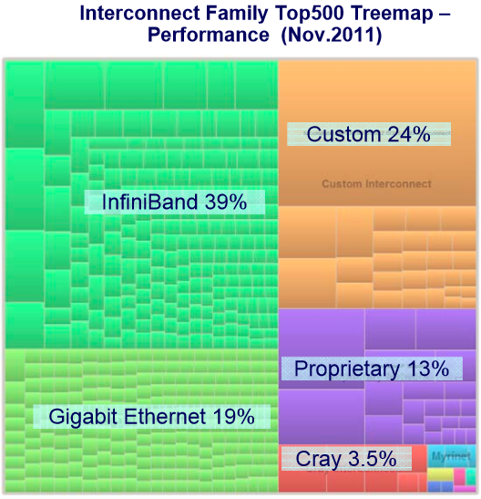
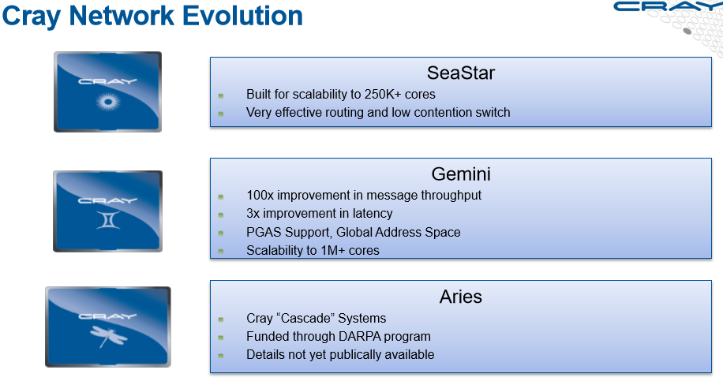
Overview on Supercomputer Interconnect Family

Slide 3
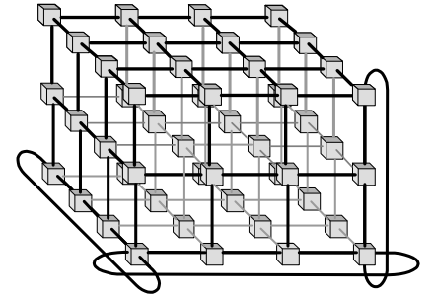
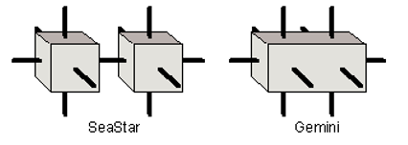
The Gemini system
MPI Network used by Cray’s supercomputers
Uses 3D torus network topology
CRC checked at each node
Each physical chip has 2 nodes
Sliding window protocol
Data transfers bypass OS

Slide 4
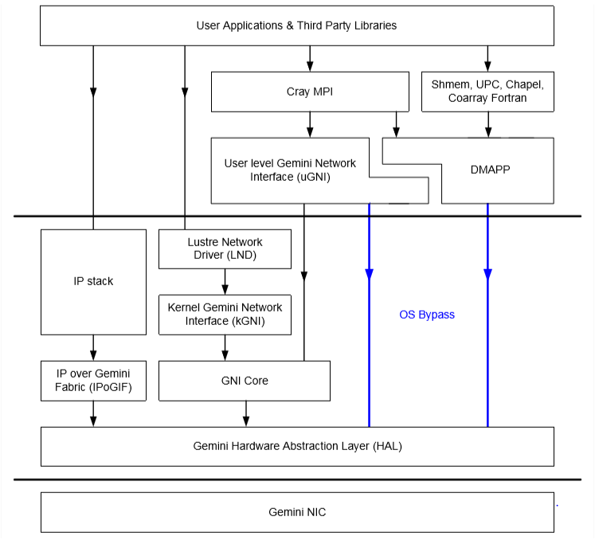
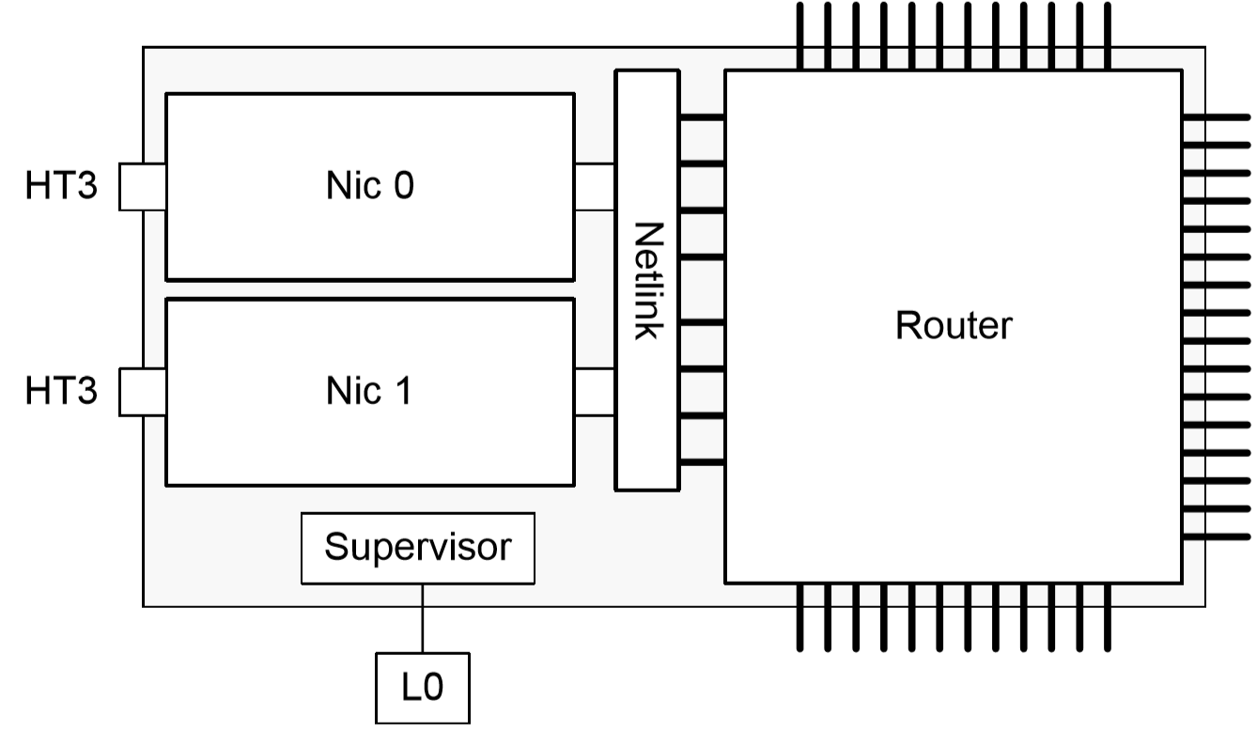
Gemini Software Stack

Slide 5
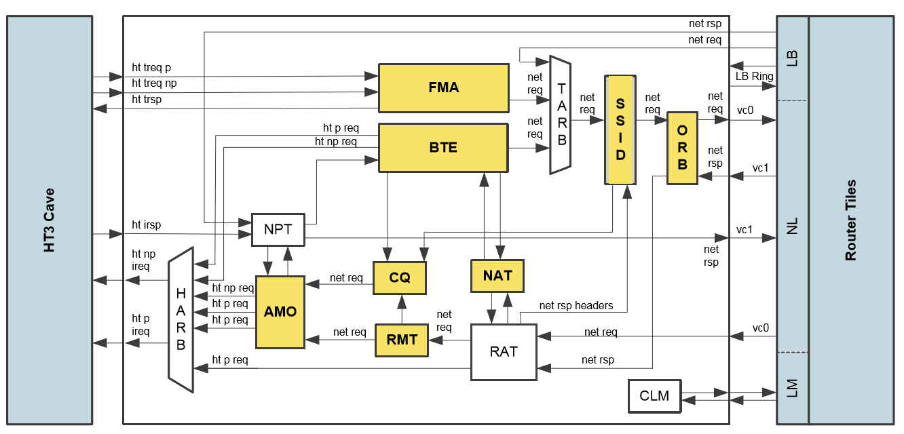
Gemini Network Interface Controller (NIC)
Atomic Memory Operations (AMO)
Get, put, etc.
Fast Memory Access (FMA)
64 byte remote read/writes
Low latency
Block Transfer Engine (BTE)
Larger transfers between local and remote memory
Up to 4GB without CPU involvement
Completion Queue (CQ)
Notifications of FMA or BTE
Synchronization Sequence Identifier (SSID)
Packets need not arrive in order, nor be reordered
Receive Message Table (RMT) tracks received packets

Slide 6
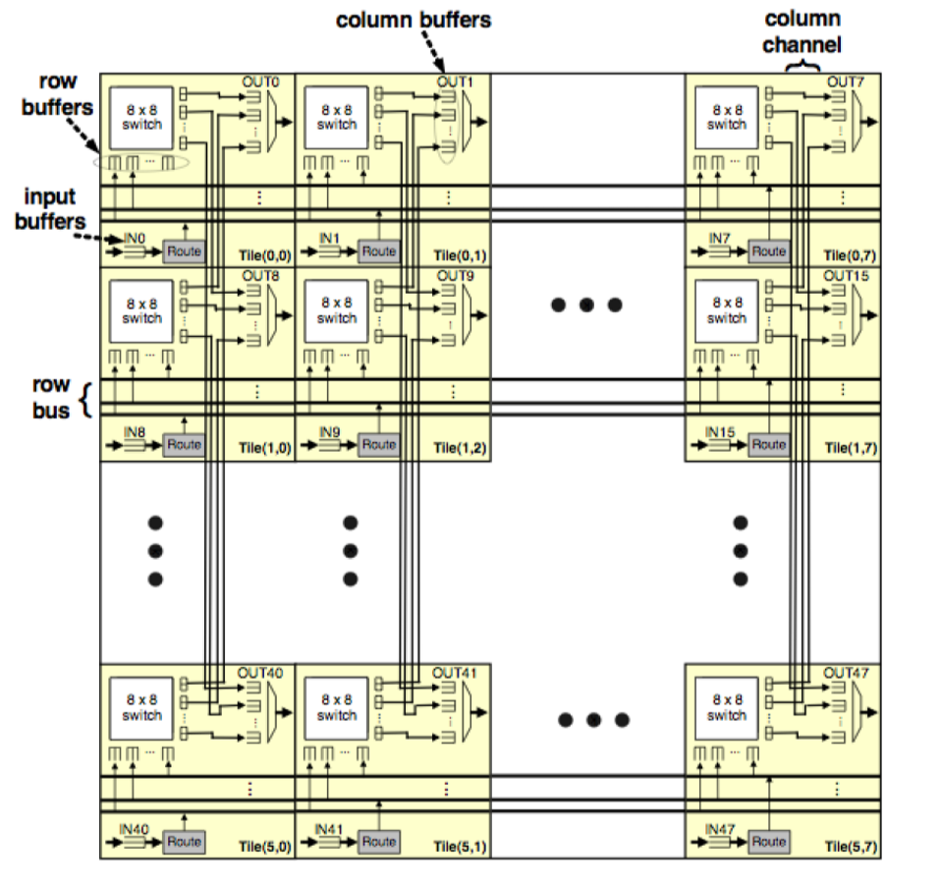
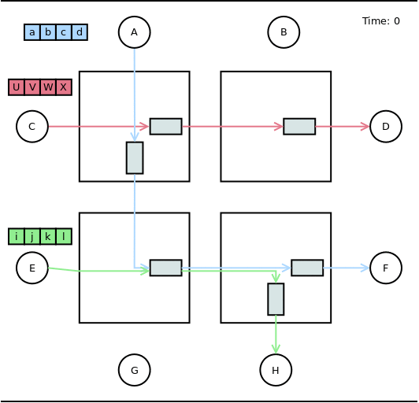
Gemini Router
Tile: 1 input port, 1 output port, 1 8x8 switch, buffers
Virtual cut-through flow control
Wormhole switching
Notes:
virtual cut-through flow control across the network links,
but uses wormhole flow control internally due to buffer size constraints

Slide 7
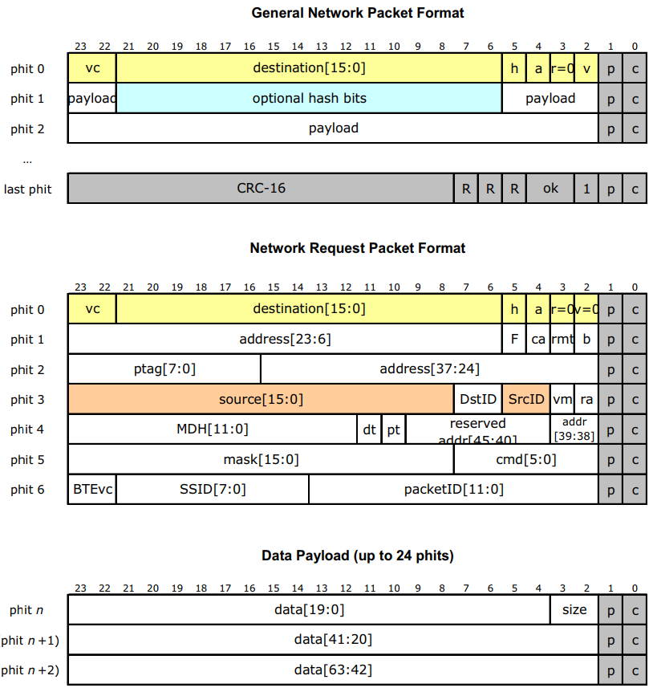
Packet Format
Uses 24-bit ‘physical units’ (phits)
Last phit signals end of packet
18-bit node addresses
Up to 45-bit virtual memory address

Slide 8
Fault Tolerance
16-bit packet CRC
64 bytes of data + associated headers (96 bytes max)
each torus connection comprises 4 groups of 3 lanes
automatic link-level retry on error
failure of a single lane
complete failure of a link
ECC for major memories and data paths protection
completion events
Notes:
16-bit packet CRC
64 bytes of data + associated headers (96 bytes max)
Gemini is designed for large systems in which failures are to be expected and applications must continue to run in the presence of errors.
Each torus connection comprises 4 groups of 3 lanes.
Packet CRCs are checked by each device with automatic link-level retry on error.
The failure of a single lane is tolerated by shunting its data to the remaining 2 lanes in the group.
Complete failure of a link would be Mask out
ECC
completion events includes details of each transaction status
The CRC is also checked as a packet leaves each Gemini and as it transitions from the router to the N tection of errors occurring within the router core. If the checksum is incorrect, the packet is marked as bad and passed on; it will be dropped by the destination Gemini

Slide 9
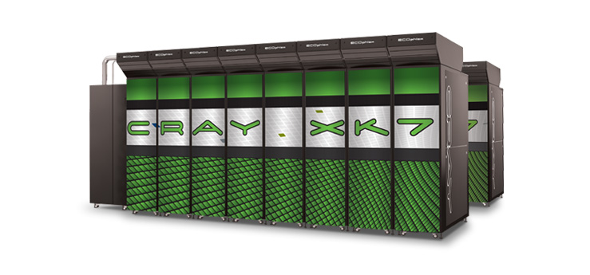
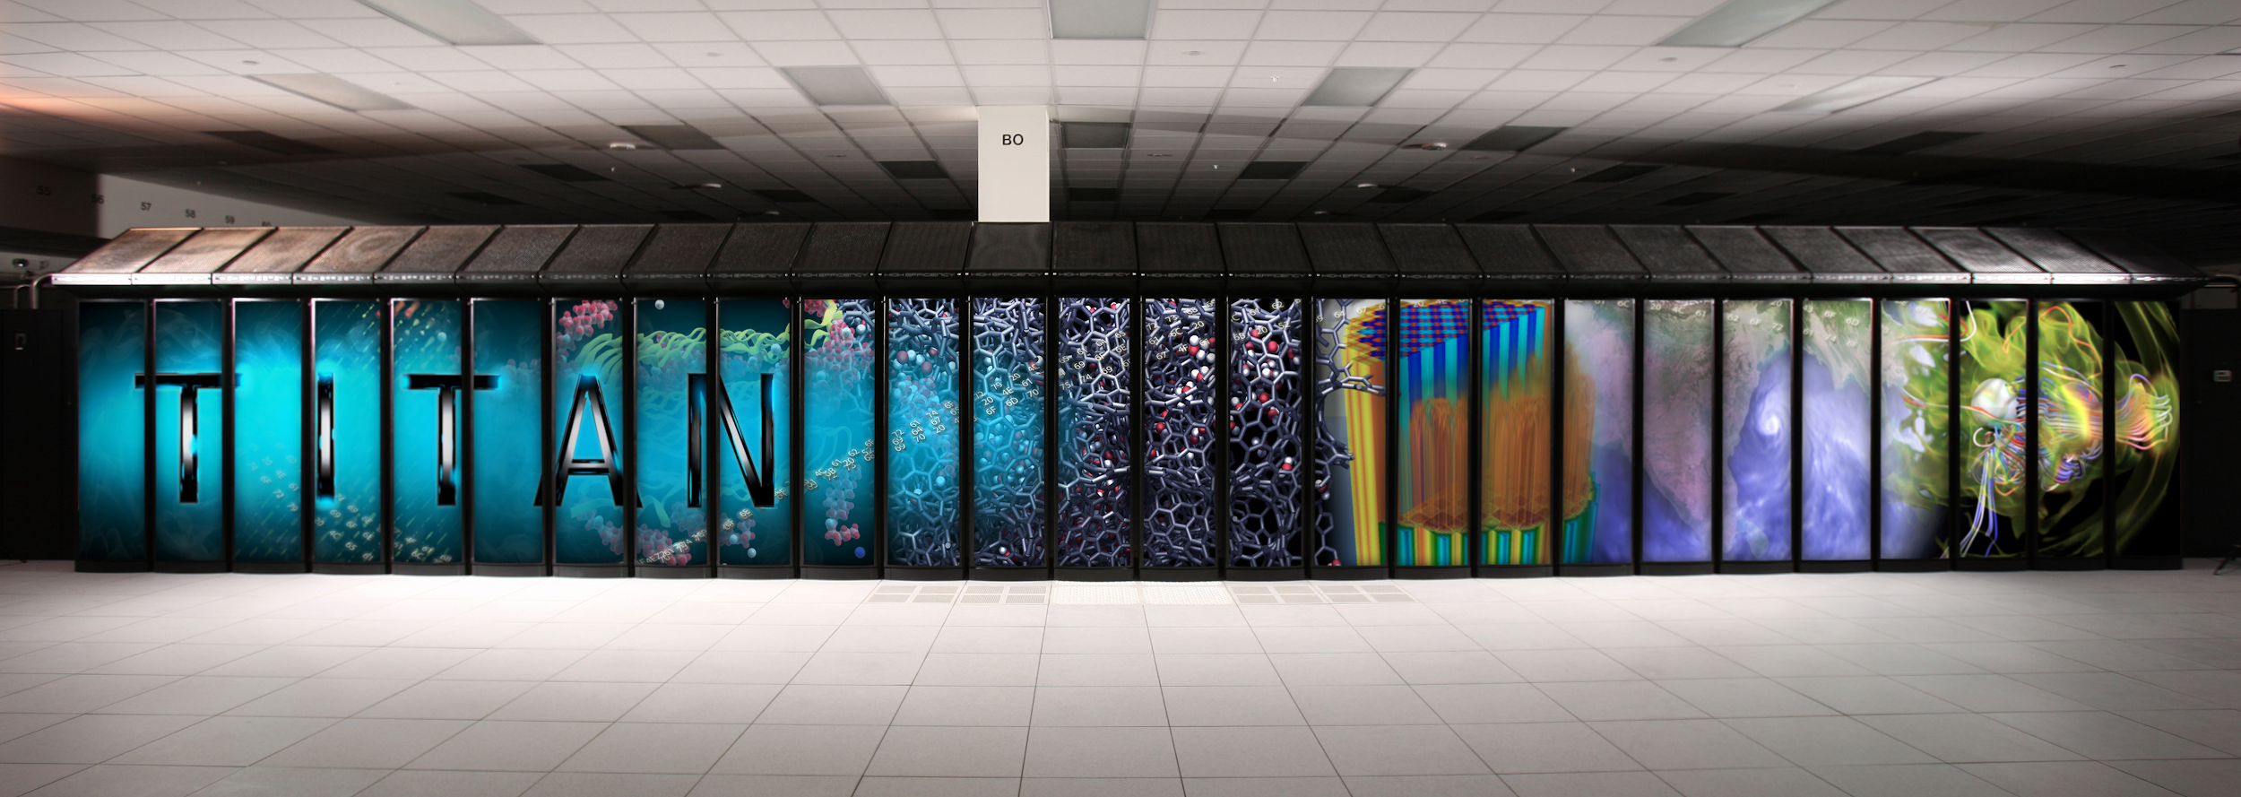
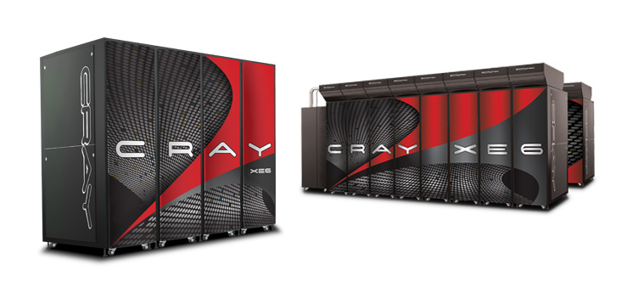

Slide 10
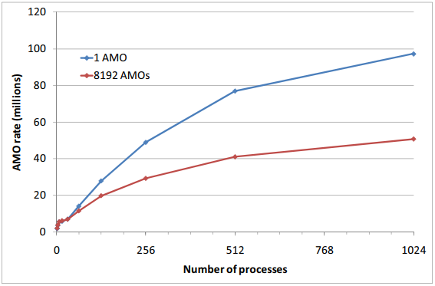
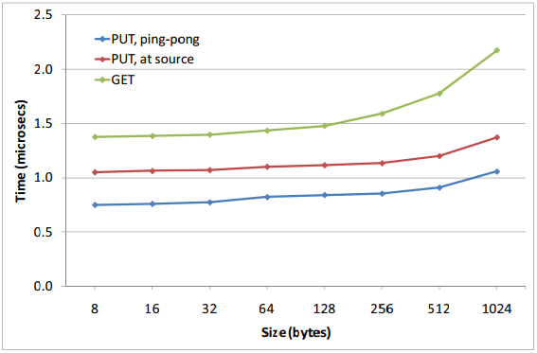
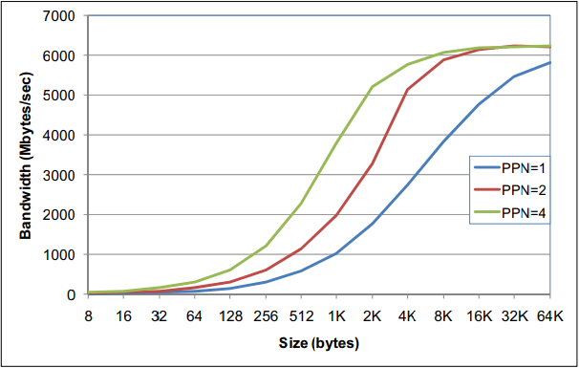
Latency & Bandwidth
On a quiet network
<1.5 us for small message (<=128 bytes)
Typically ~105 ns latency per hop

Slide 11
References
https://www.cray.com/products/computing/xe-series
https://www.cray.com/products/computing/xk-series
https://de.wikipedia.org/wiki/Cray_XK7#/media/File:Titan_supercomputer_at_the_Oak_Ridge_National_Laboratory
https://www.olcf.ornl.gov/wp-content/uploads/2013/02/Titan_Architecture_1-JL.pdf
Abts, D. (2010). The Cray XT4 and Seastar 3-D Torus Interconnect.
Alverson, B., Froese, E., Kaplan, L. and Roweth, D. (2012). Cray ® XC™ Series Net work.
Alverson, R., Roweth, D. and Kaplan, L. (2010). The Gemini System Interconnect. 2010 18th IEEE Symposium on High Performance Interconnects.
Benner, A. (2012). Optical Interconnect Opportunities in Supercomputers and High End Computing.
Inc, C. (2019). The Gemini Network.
Larkin, J. (2012). Titan Architecture.
Sun, Y., Zheng, G., Kalé, L., Jones, T. and Olson, R. (2012). A uGNI-based Asynchronous Message-driven Runtime System for Cray Supercomputers with Gemini Interconnect. 2012 IEEE 26th International Parallel and Distributed Processing Symposium.
Vaughan, C., Rajan, M., Barrett, R., Doerﬂer, D. and Pedretti, K. (2019). Investigating the Impact of the Cielo Cray XE6 Architecture on Scientiﬁc Application Codes.
Vishnu, A., Bruggencate, M. and Olson, R. (2019). Evaluating The Potential of Cray Gemini Interconnect for PGAS Communication Runtime Systems.

